Slide 1

MONTHLY EXPENSE
& BUDGET ANALYZER
Name | Rollno
Sandeep | 2620090082
Sai Dhruva | 2620080118
Bhargav Sri Datta | 2620090060
Under Guidance:
G. Mamatha

Slide 2
Abstract
The Monthly Expense & Budget Analyzer is a Java-based application developed to help users manage their monthly income, monitor expenses, and control spending. It allows users to set a monthly budget, record expenses under different categories, calculate total expenditure and remaining balance, and receive budget status alerts.
The project provides a web-based dashboard with a Java backend and an additional console-based interface. It uses HTML, CSS, and JavaScript for the user interface and Java for calculations, data handling, and HTTP API operations. The system helps users understand their spending patterns and make better financial decisions.

Slide 3
Problem Statement
Manual expense tracking is time-consuming and difficult to maintain.
Users may lose track of their monthly spending across different categories.
Overspending can go unnoticed until the budget is exhausted.
Calculating total expenses and remaining income manually can lead to errors.
Users need a simple system to monitor financial status and identify spending patterns
Problem addressed: The lack of a simple, centralized application for tracking monthly expenses and monitoring budget limits.

Slide 4
Proposed Solution
The proposed system provides a centralized expense management dashboard that automates financial calculations and budget monitoring.
Record expenses with descriptions, categories, amounts, and dates.
Set monthly income and budget limits.
Automatically calculate total expenses and remaining balance.
Display budget consumption and status alerts.
Show category-wise expense breakdowns.
View, filter, and delete recorded expenses.
Provide both web-based and console-based interfaces.

Slide 5
Objectives
Develop a user-friendly expense tracking application.
Automate monthly expense and balance calculations.
Categorize spending for easier financial analysis.
Monitor budget utilization and identify overspending.
Display financial information through a clear dashboard.
Apply Java programming concepts, conditional statements, collections, and web technologies in a practical project.

Slide 6
Methodology
Requirement Analysis: Identify income tracking, expense recording, and budget monitoring requirements.
Frontend Development: Build the dashboard using HTML, CSS, and JavaScript.
Backend Development: Implement a Java HTTP server and REST API endpoints.
Data Processing: Store expense records, calculate totals, and group expenses by category.
Budget Analysis: Compare total expenses with the budget using conditional statements.
Testing: Verify expense addition, deletion, budget updates, calculations, and reset functionality.

Slide 7
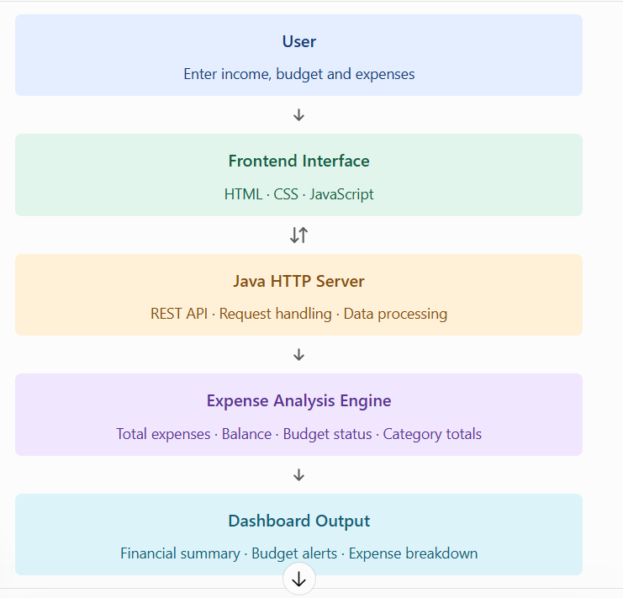
System Architecture / Workflow

Slide 8
Implementation / Prototype
1. Financial Dashboard
  Displays monthly income, budget, total expenses, remaining balance, and budget consumption percentage.
2. Expense Management
  Allows users to add expenses, select categories, enter amounts and dates, filter records, and delete entries.
3. Budget Analysis
  Displays category-wise spending and indicates whether spending is within, equal to, or above the budget.

Slide 9
Conclusion and Future Scope
Conclusion
The Monthly Expense & Budget Analyzer provides a simple way to record expenses, monitor monthly spending, and evaluate budget utilization. It demonstrates practical applications of Java programming, web development, HTTP APIs, data processing, and conditional logic. The dashboard makes financial information easier to understand and supports more informed spending decisions.
Future Scope
Integrate a database such as MySQL or PostgreSQL for persistent storage.
Add user authentication and individual financial accounts.
Generate monthly reports and PDF/Excel exports.
Provide spending trends and graphical analytics.
Add savings goals, recurring expenses, and notifications.
Develop a mobile-friendly application and deploy it online.

Slide 10
THANK YOU

